Slide 1

US Demographics
Alchemy Group

Slide 2
Agenda
Project Details
Questions Overview
Jira Presentation
Example of a Query
Analysis Presentation
Q&A

Slide 3
Project Details
Kaggle
Tech Stack:
Apache Spark
Spark SQL
YARN
HDFS
Scala
Git + GitHub
Excel
Python - Seaborn
Notes:
We used all the required technologies and added Python: Seaborn

Slide 4
Questions Overview
How does the ratio between male and female correlate to divorce rates
How does wealth correlate with divorce rates?
What are the ten wealthiest area codes in the US?
Is rent directly proportional to income in any given US city?
Do high school degrees correlate with less debt?
Do college degrees correlate with less debt?
Do more high school degrees correlate with higher rent?
Is rent correlated with water prices in any given area?
Are debt and home ownership correlated?
Does a larger population mean more higher rent?

Slide 5
What data did we work with?
Notes:
80 columns of data

Slide 6
Jira Presentation
Daily Stand-Ups
Sprints
Retrospectives
Notes:
Completed our project in four sprints

Slide 7
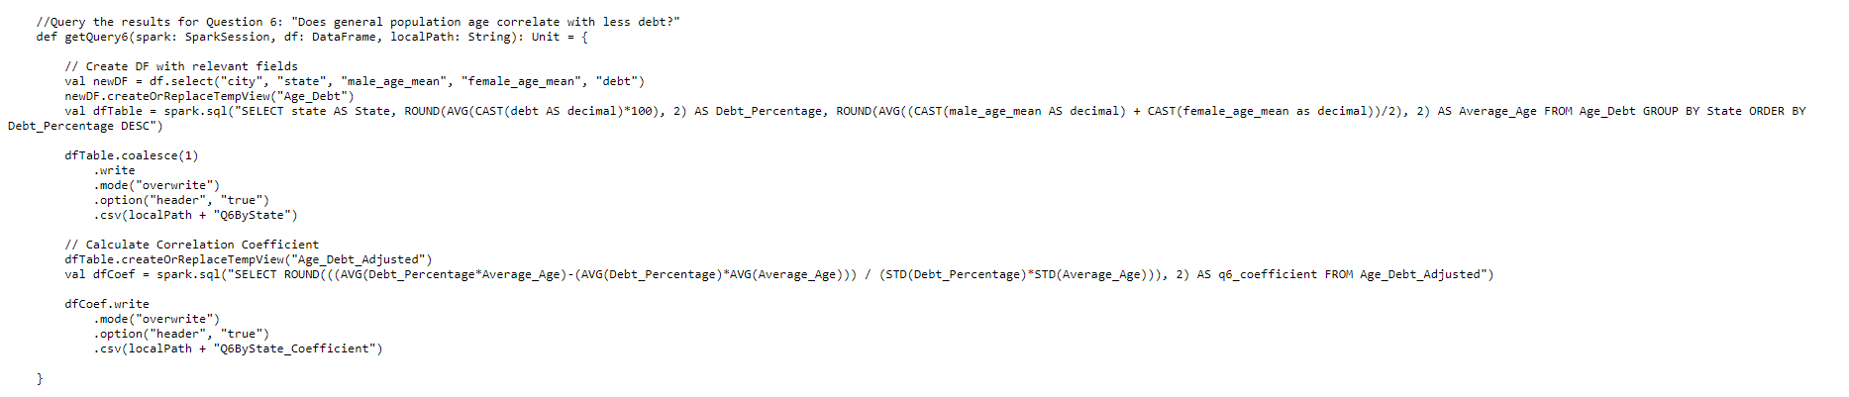
Example of a Query

Slide 8
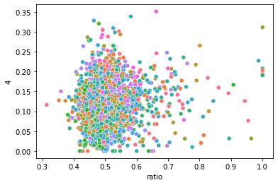
Q1: How does the ratio between male and female correlate to divorce rates?
Divorce Rate
City​ | 0.11​
Notes:
Explain what the different colors mean
What is a correlation

Slide 9
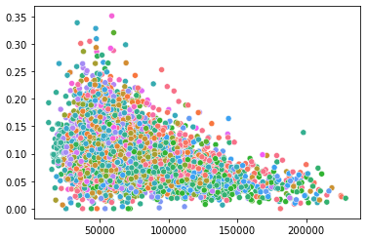
Q2: How does wealth correlate with divorce rates?
Divorce Rate
Wealth (By Income)
City​ | -0.45​

Slide 10
Q3: What are the ten wealthiest area codes in the US?
Area Codes
718
410
703
301
773
610
215
770
860
508

Slide 11
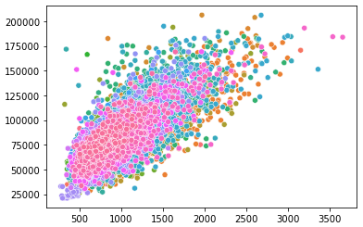
Q4: Is rent directly proportional to income within cities?
Yearly Income
Monthly Rent
City​ | 0.77​
Notes:
Charles Dang
0.8 represents a weak correlation

Slide 12
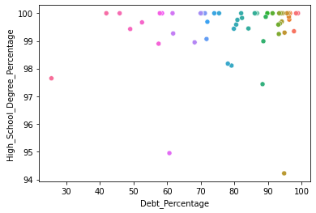
Q5: Do high school degrees correlate with less debt?
State​ | 0.12​

Slide 13
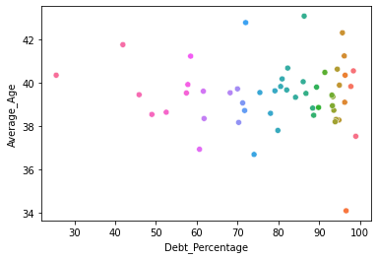
Q6: Does general population age correlate with less debt on the state level?
State​ | -0.07​

Slide 14
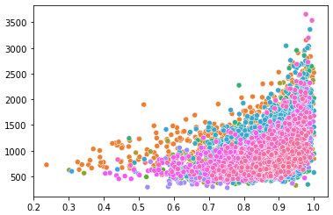
Q7: Is the mean rent correlated with high school graduation in a city?
Mean Rent
HS Graduation Rate
City​ | 0.39​

Slide 15
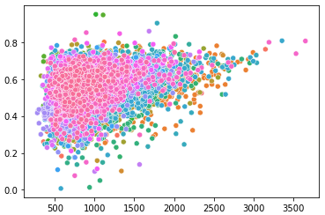
Q8: Is rent correlated with marriage rates in any given US city?
Marriage Rates
Monthly Rent
City​​ | 0.18​​
Notes:
Charles Dang

Slide 16
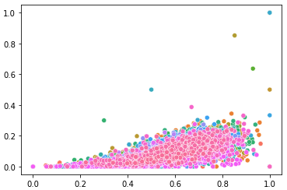
Q9: Are debt and home ownership correlated?
Home Ownership
Debt
City​​ | 0.71​​

Slide 17
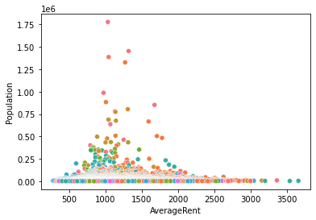
Q10: Does a larger population mean higher rent?
City​​ | 0.13​​

Slide 18

Summary
There were a lot of confounding variables

Slide 19
Q & A

